Slide 1

BEDHUNTER
Authors: Almási Boglárka, Lévai Viktória Anna, Gábor Dénes

Slide 2
The problem
There’s no hotel booking platform for a specific city/area that’s user-friendly and easy to understand
The solution
Standarized platform
Simplifed application
Easy browsing

Slide 3
Functions of the program for users
Registration
Login
Hotels browsing
Reservation
Check contact

Slide 4
Functions of the program for admins
Registration
Login
Create, edit and delete hotels
Edit and delete users
View all booking data

Slide 5
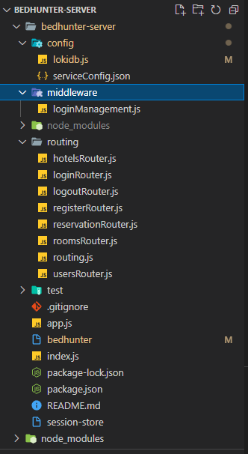
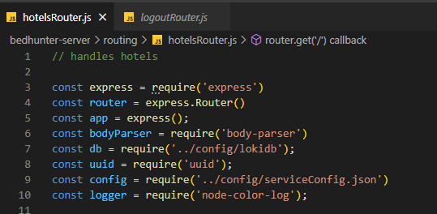
Backend
Node 16.10.0.v. with express.js
Cors - Cross-Origin Resource Sharing
CRUD functions
Database connection

Slide 6

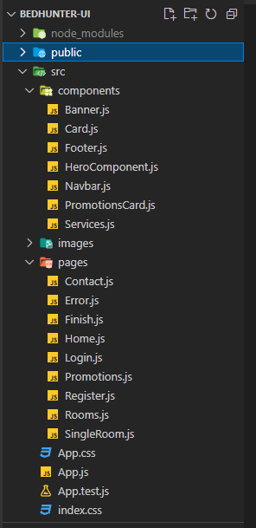
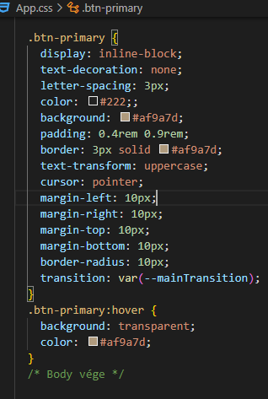
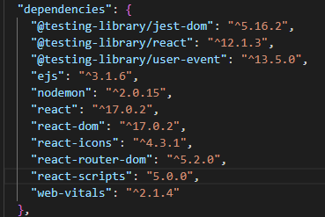
Frontend
React 17.0.2.v.
CSS
Dependencies

Slide 7
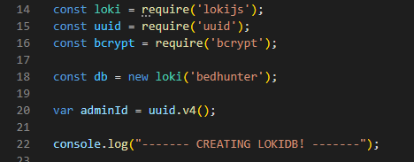
Database
No SQL
6 collections
Generated when running applicatioin

Slide 8
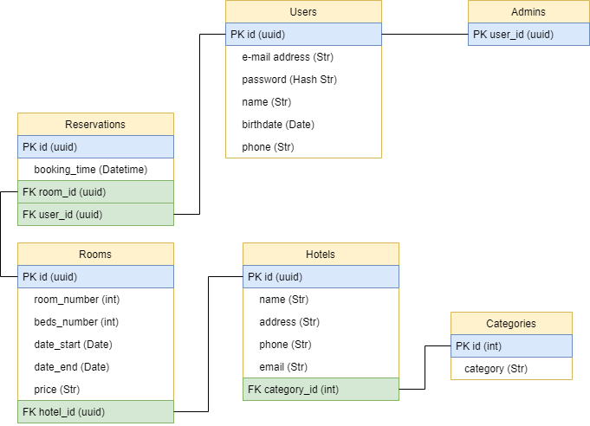
UML diagram

Slide 9

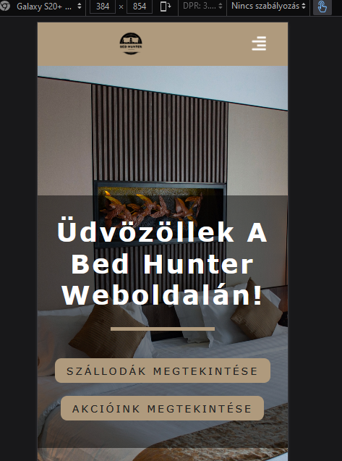
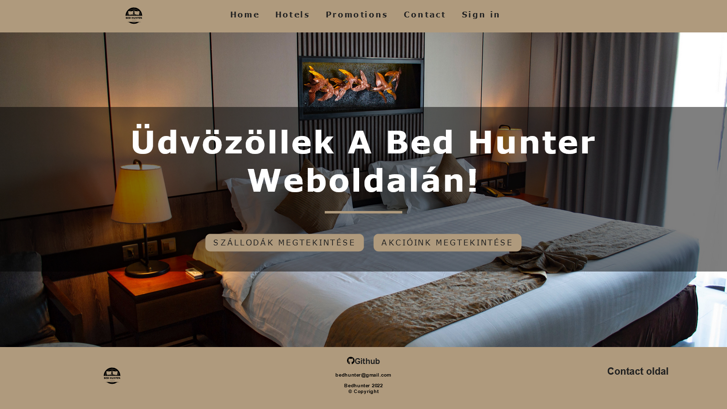
Responsivity
Optimized for mobile devices and all screen types
Acces from anywhere

Slide 10

Tests
Postman tests

Slide 11




Teamwork
Discord
Github
Facebook messenger
Google Drive

Slide 12
Teamwork tasks Frontend
Lévai Viktória Anna
React:
Components: Navbar, Footer, Banner, HeroComponent, Card, PromotionsCard
Pages: Home, Login, Register, Rooms, Promotions, Finish, Error
Style: CSS
Logo making

Slide 13
Teamwork tasks Backend
Almási Boglárka
Backend: Creating database connection, GET, POST, PUT, DELETE requests, password encrypting with bcrypt
Backend testing: Postman collection tests
Database: Local database (Loki.js)

Slide 14

The future
Online payment
Admin UI
Connection to booking systems in the hotels
Search functions

Slide 15
BedHunter Demo

